Slide 1

# m.O.O.S.E. #

Slide 2
# m.O.O.S.E. #
FUNCTIONAL
TASKING
AI
CARGO
WRAPPER
CORE
DCS WORLD API

Slide 3

ai - air to air dispatching

Slide 4
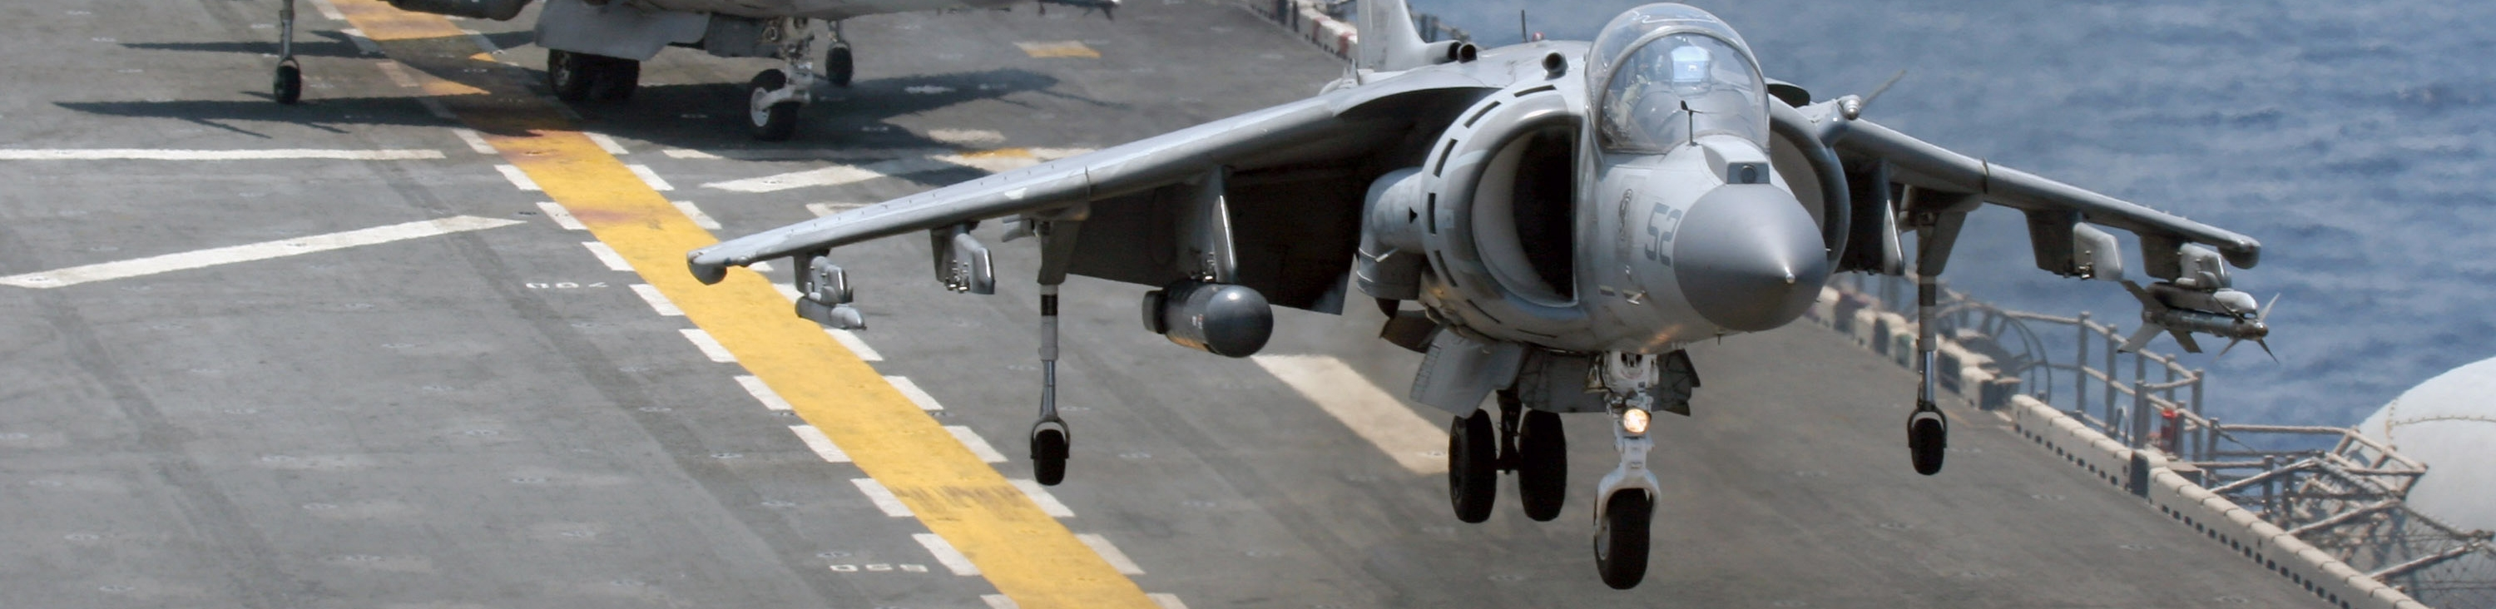
ai - air patrolling

Slide 5

ai - combat air patrol (cap)

Slide 6
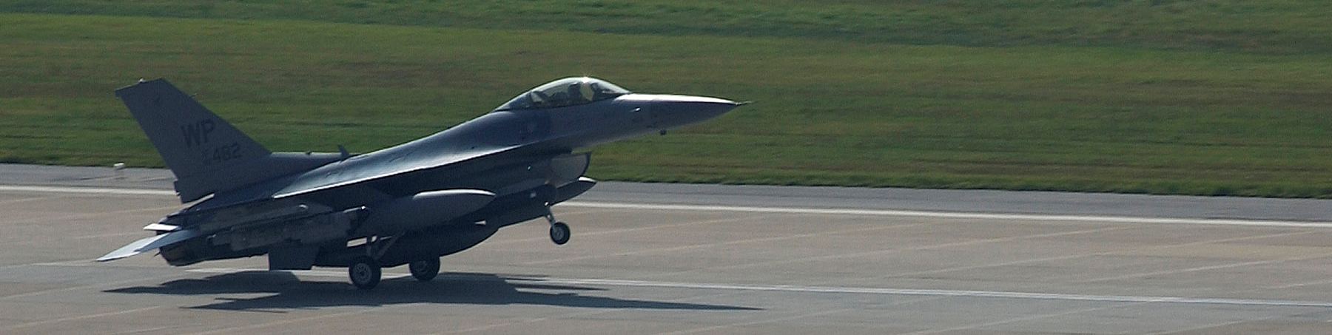
ai - ground control intercept (gci)

Slide 7

ai - close air support (cas)

Slide 8
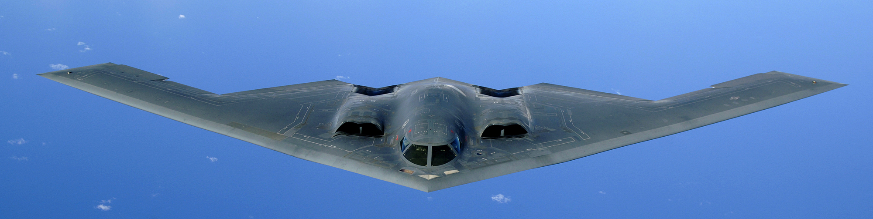
ai - battlefield air interdiction (bai)

Slide 9

ai - balancing

Slide 10
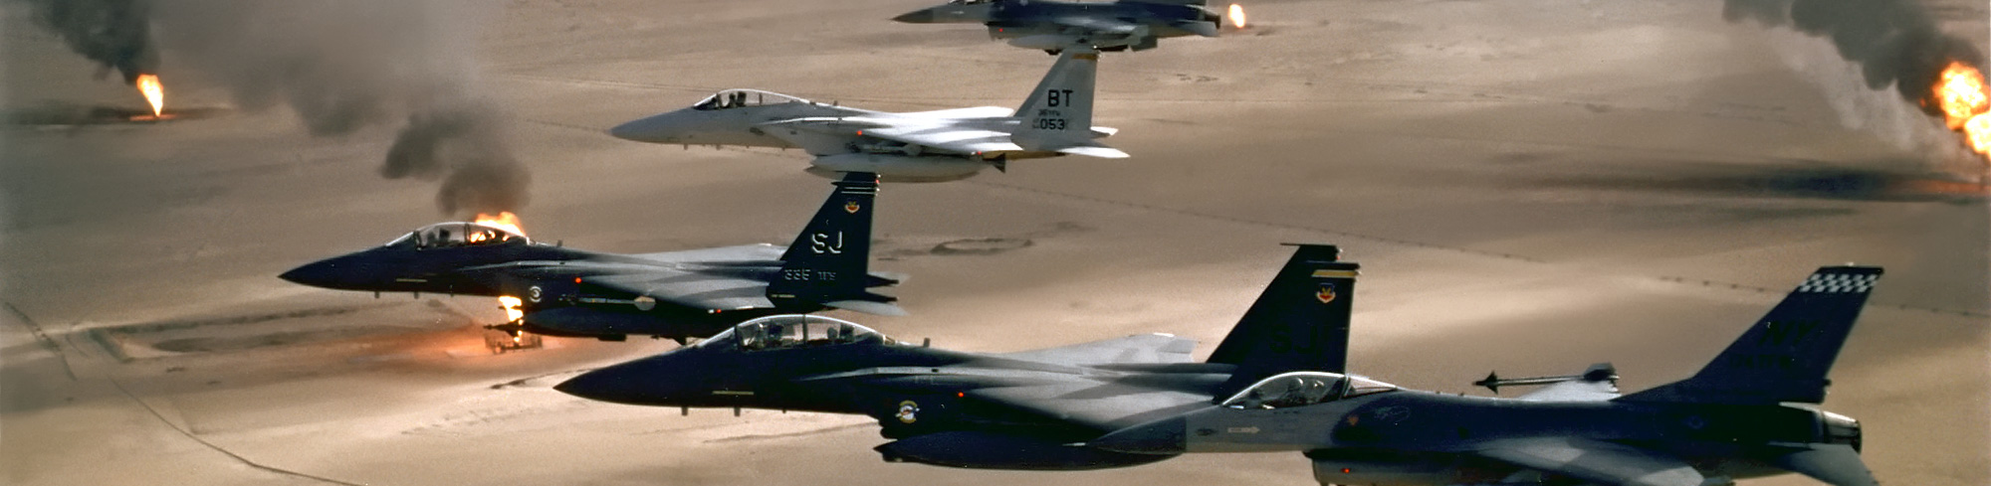
ai - large formations

Slide 11

ai - cargo dispatching for apc

Slide 12
ai - cargo dispatching

Slide 13
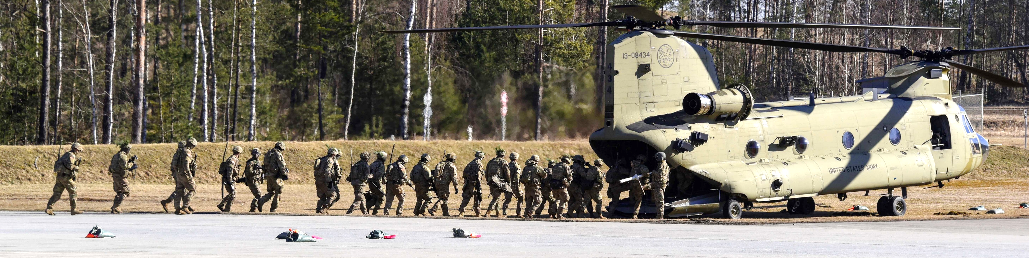
ai - cargo dispatching for helicopters

Slide 14

ai - cargo dispatching for airplanes

Slide 15

cargo

Slide 16
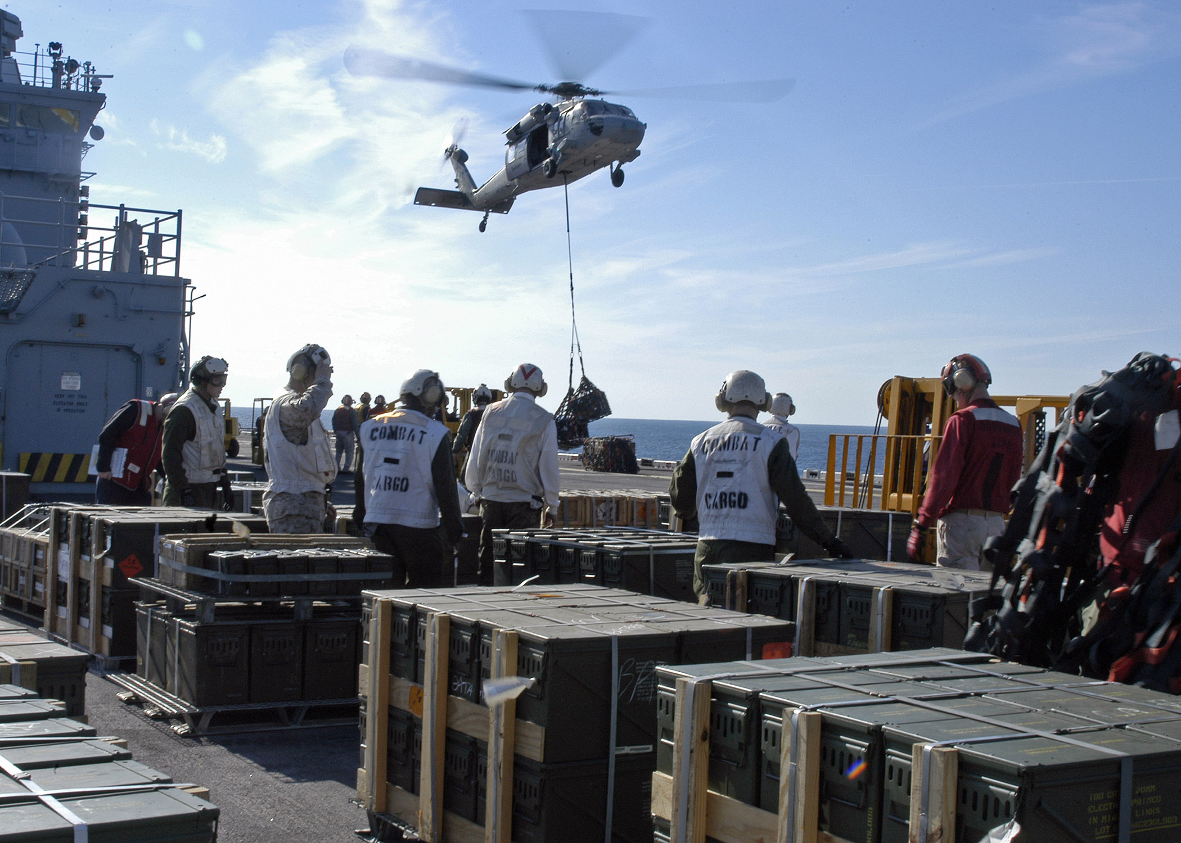
carge - crates

Slide 17
cargo - slingload

Slide 18
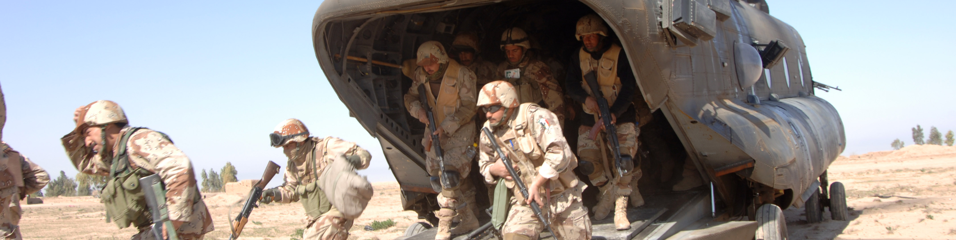
cargo - groups

Slide 19
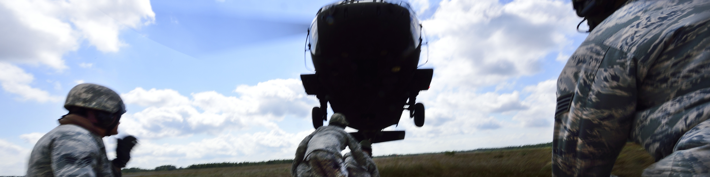
cargo - units

Slide 20
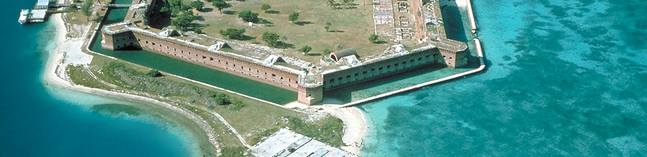
core - base

Slide 21

core - database

Slide 22
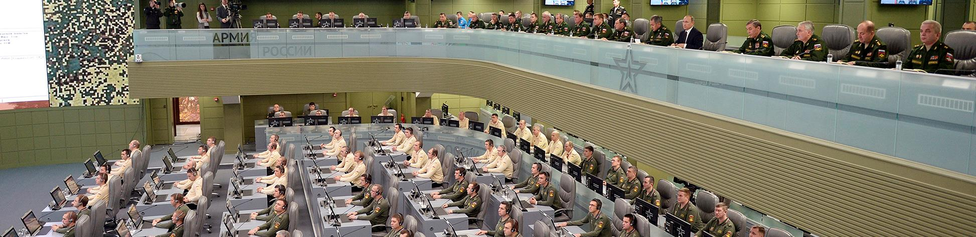
core - event

Slide 23
core - finite state machine

Slide 24
core - goal

Slide 25
core - menu

Slide 26
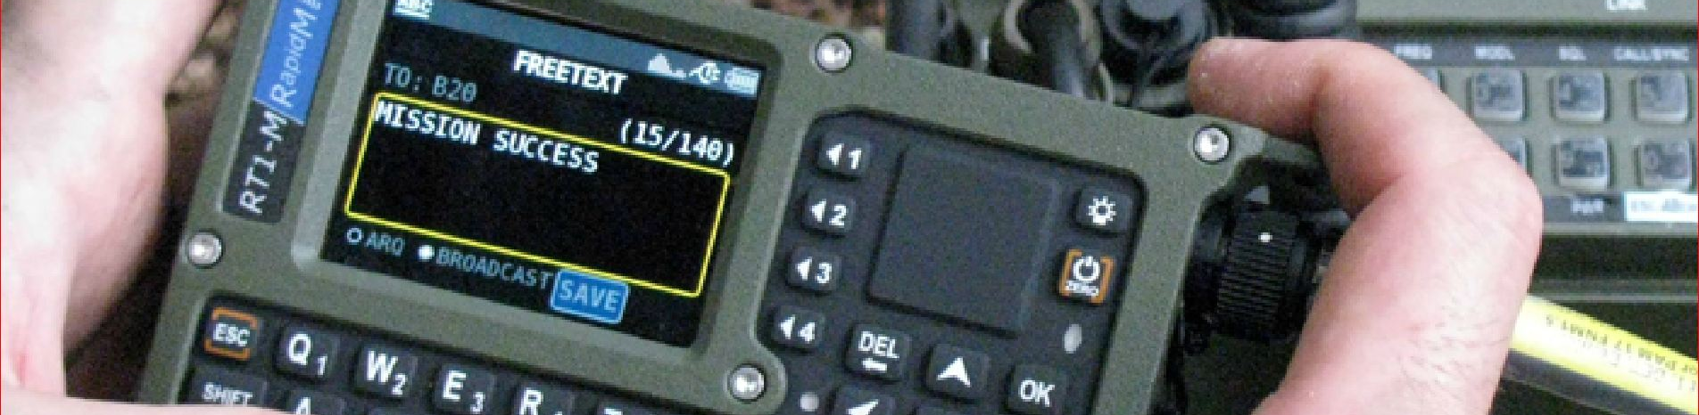
core - message

Slide 27

core - coordinate

Slide 28
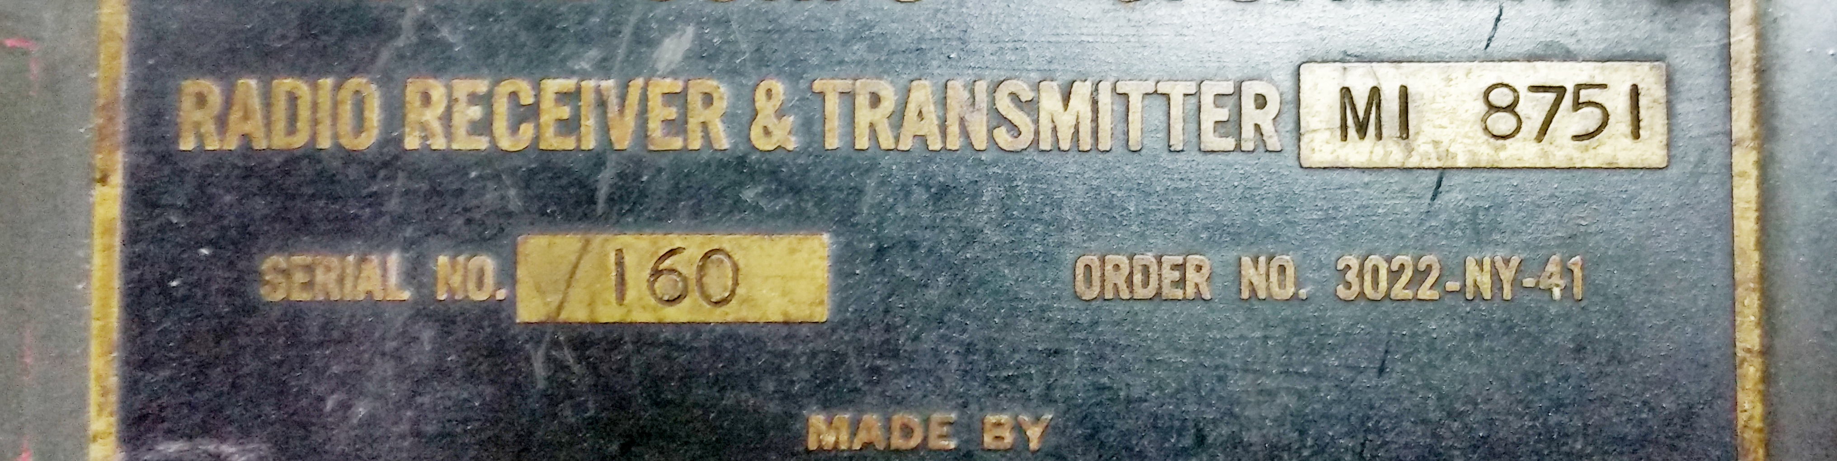
core - radio

Slide 29
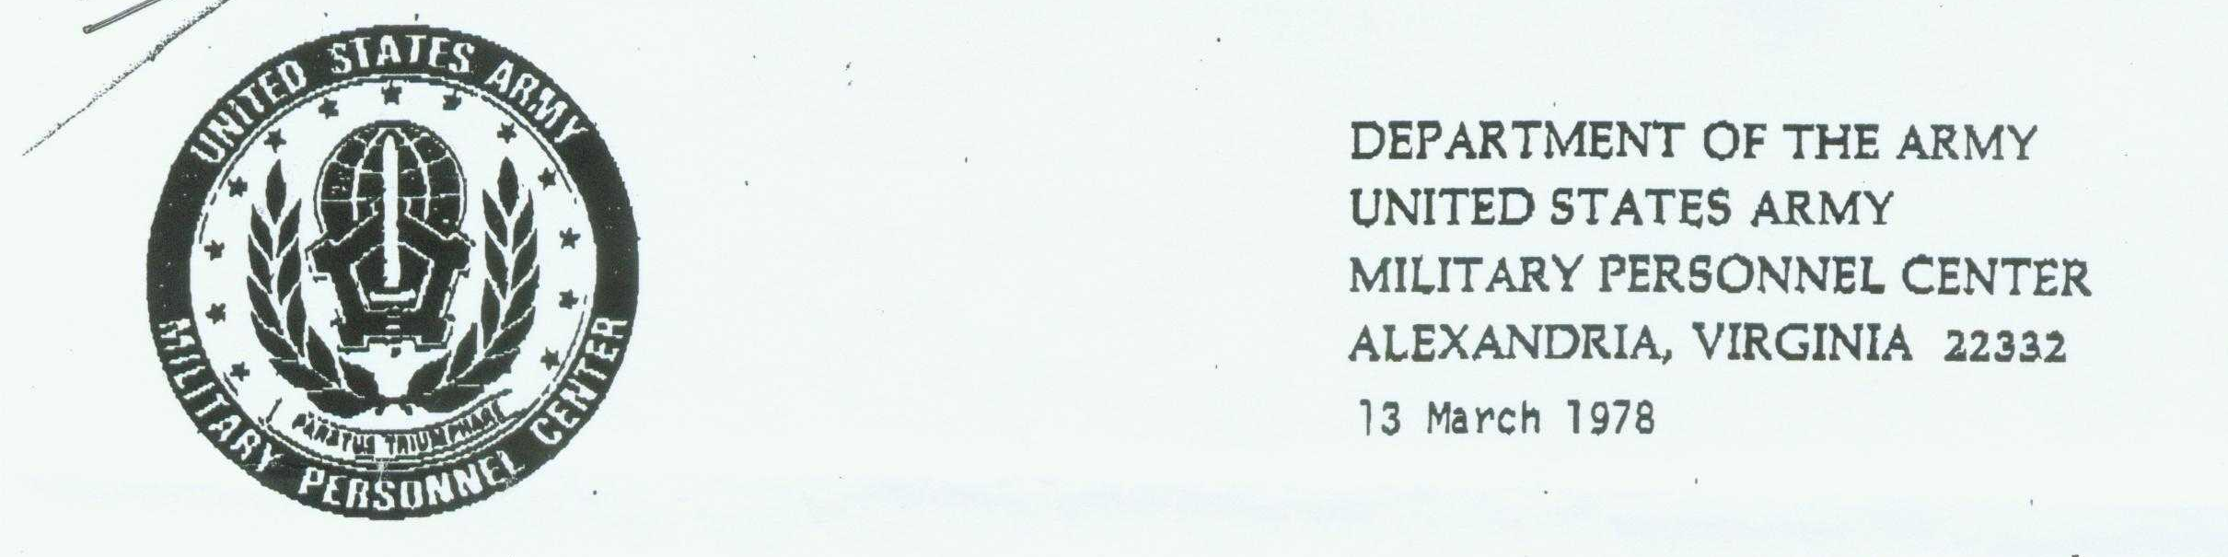
core - report

Slide 30

core - schedule dispatcher

Slide 31
core - scheduler

Slide 32
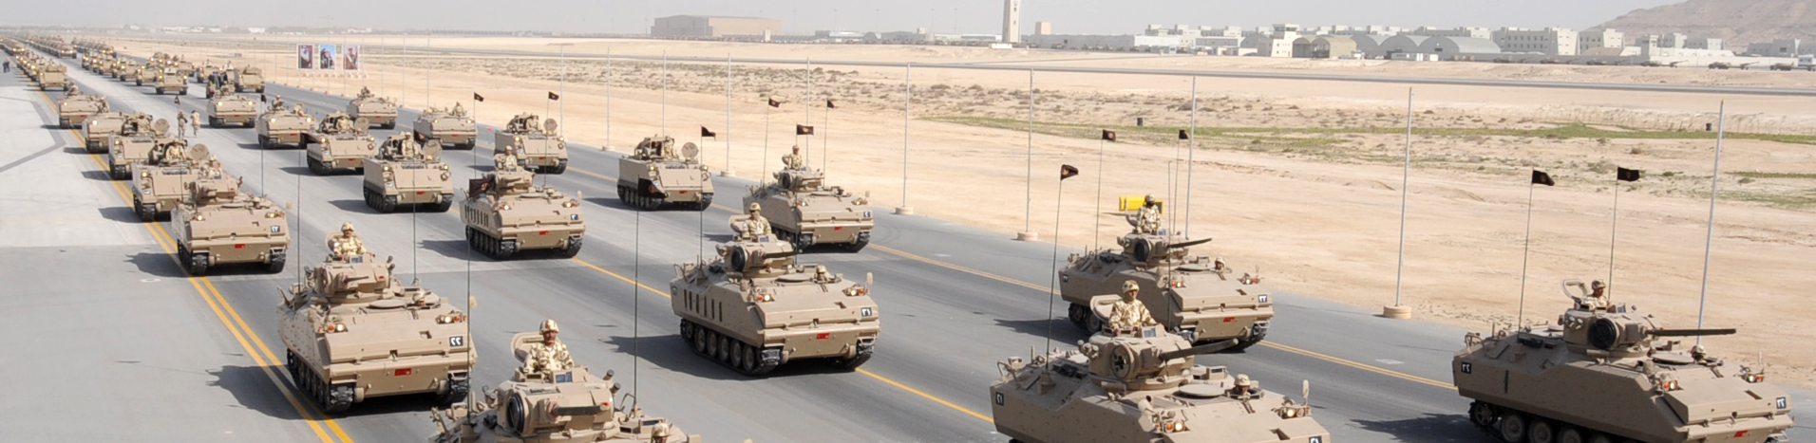
core - sets

Slide 33

core - settings

Slide 34
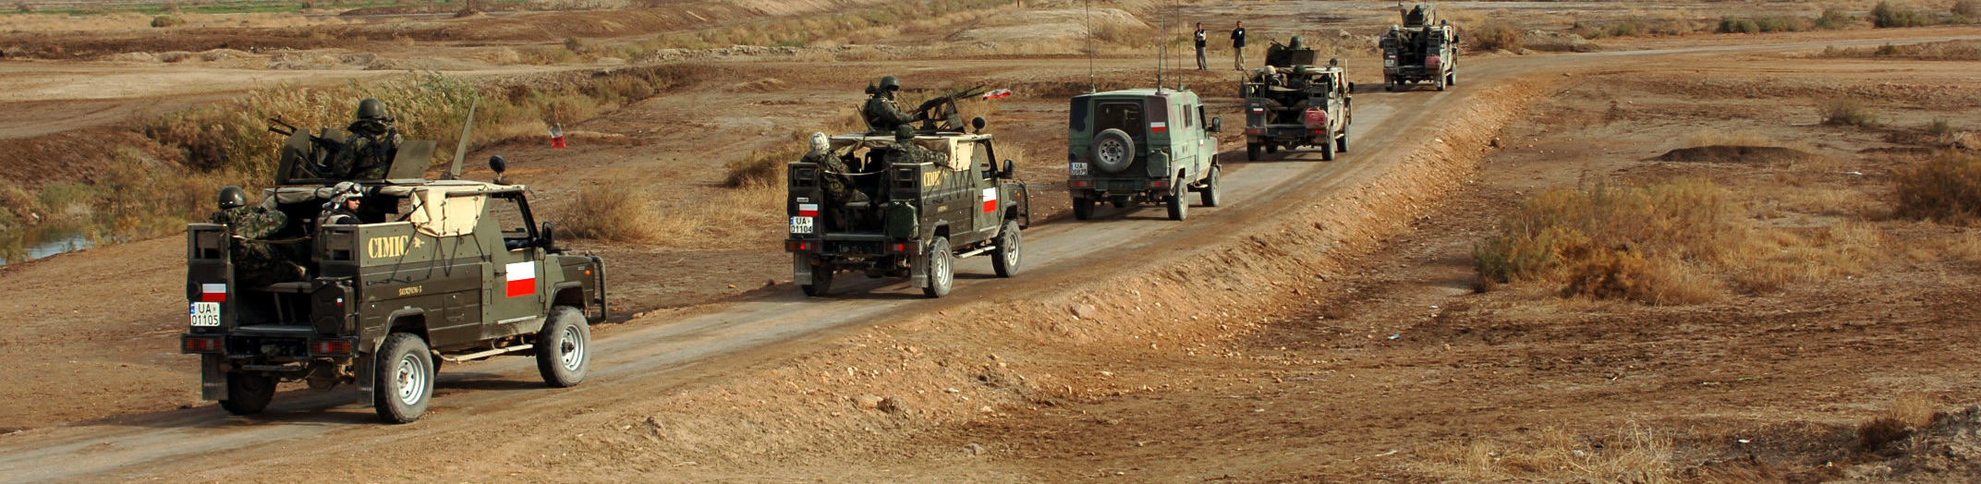
core - spawn

Slide 35

core - spawnstatic

Slide 36

core - spot

Slide 37
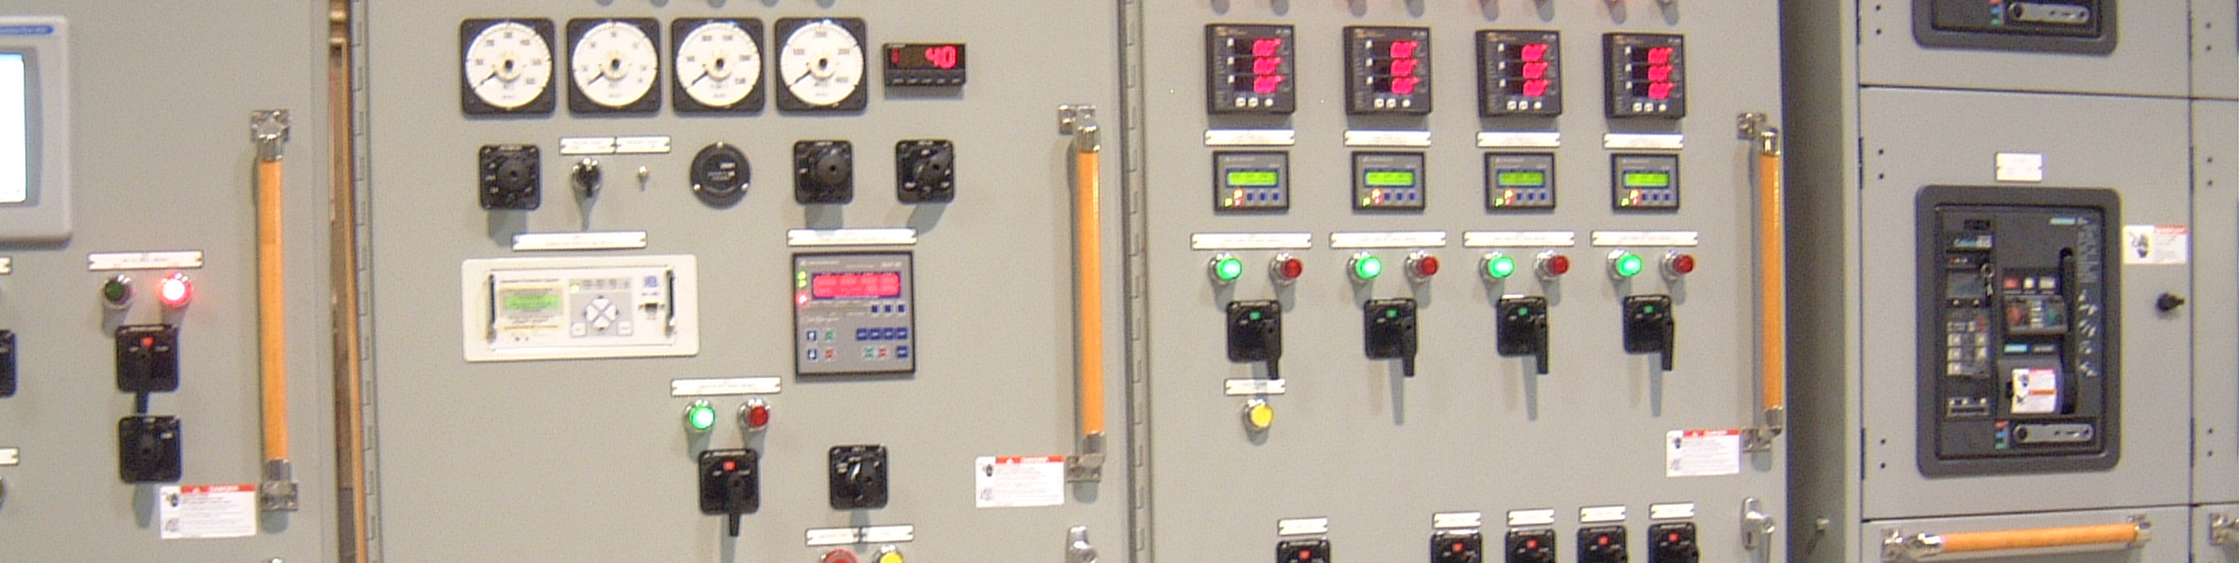
core - userflag

Slide 38
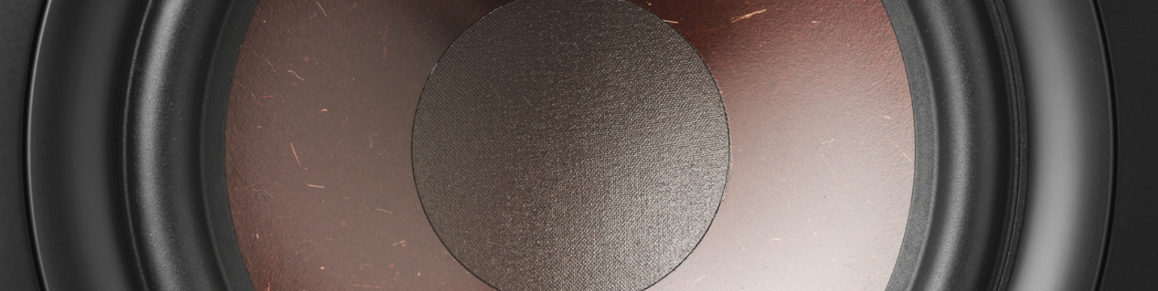
core - usersound

Slide 39
core - velocity

Slide 40
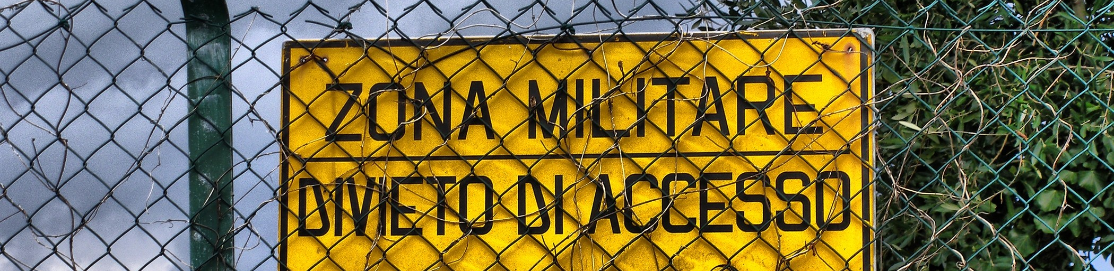
core - zones

Slide 41

atc ground operations

Slide 42
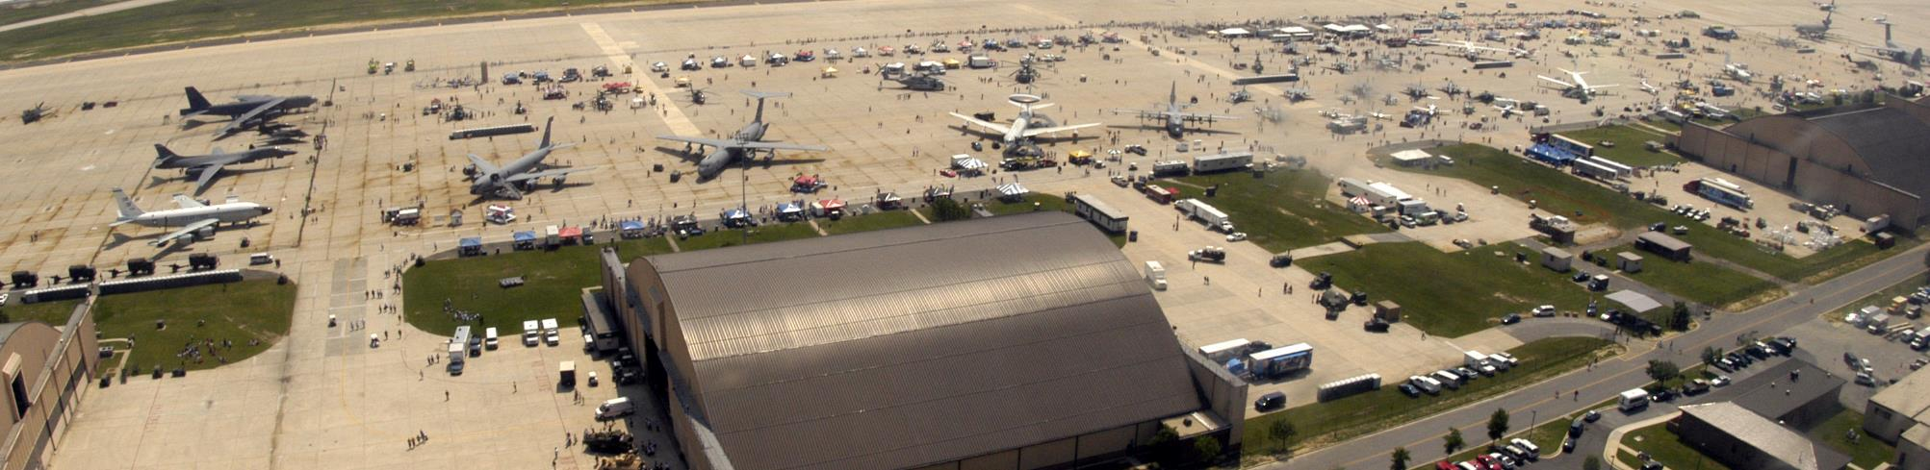
cleanup airbases

Slide 43

designation

Slide 44
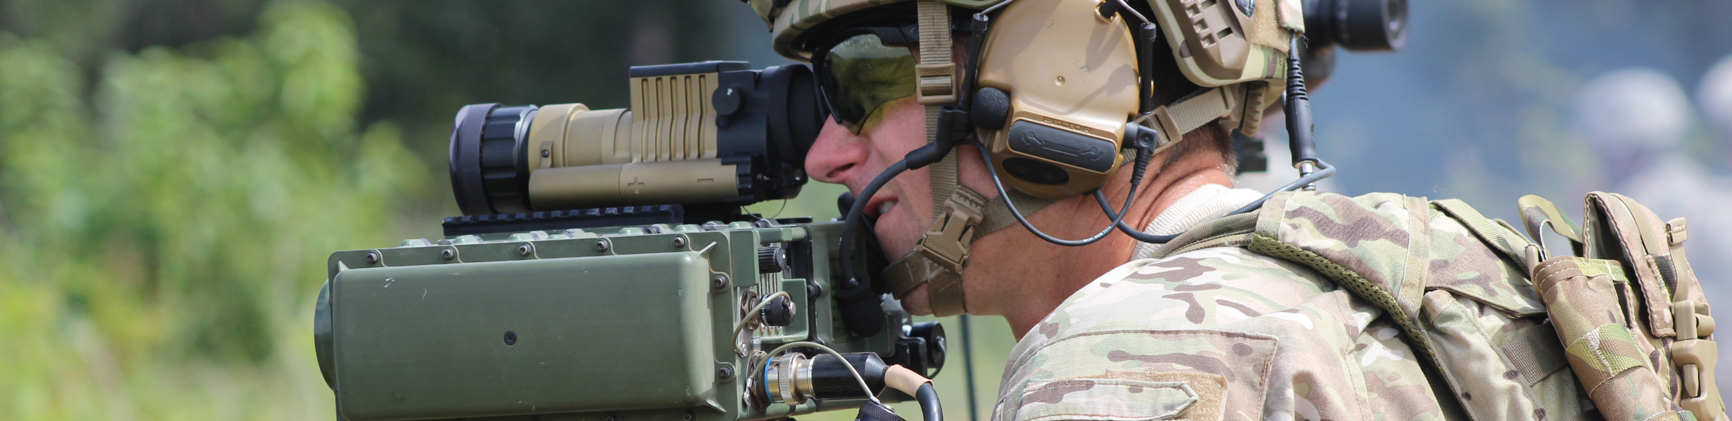
detection

Slide 45
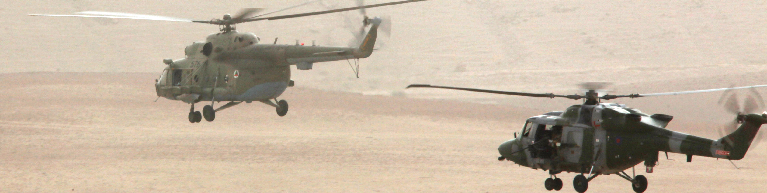
escorting

Slide 46
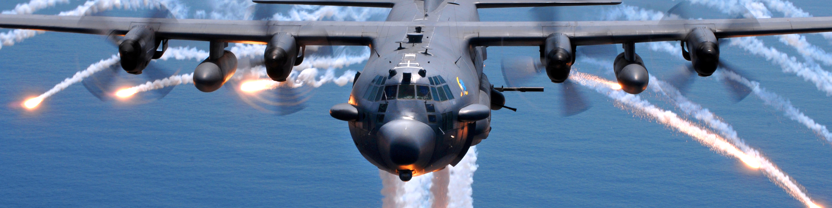
missile trainer

Slide 47
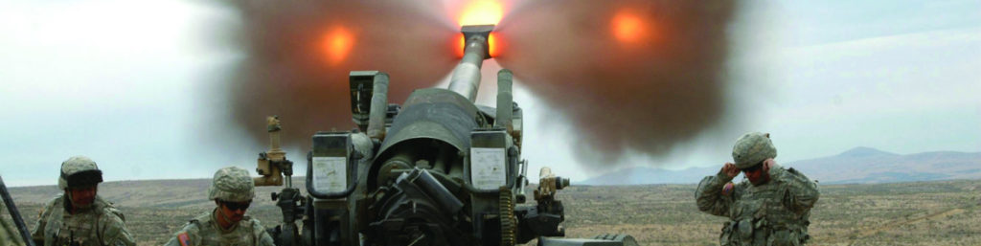
artillery

Slide 48
pseudo atc

Slide 49
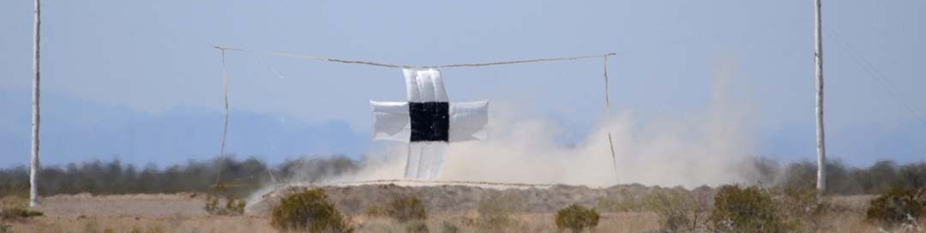
range

Slide 50
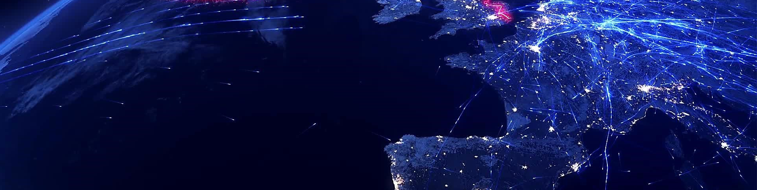
random air traffic

Slide 51
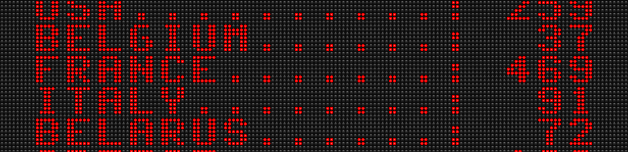
scoring

Slide 52
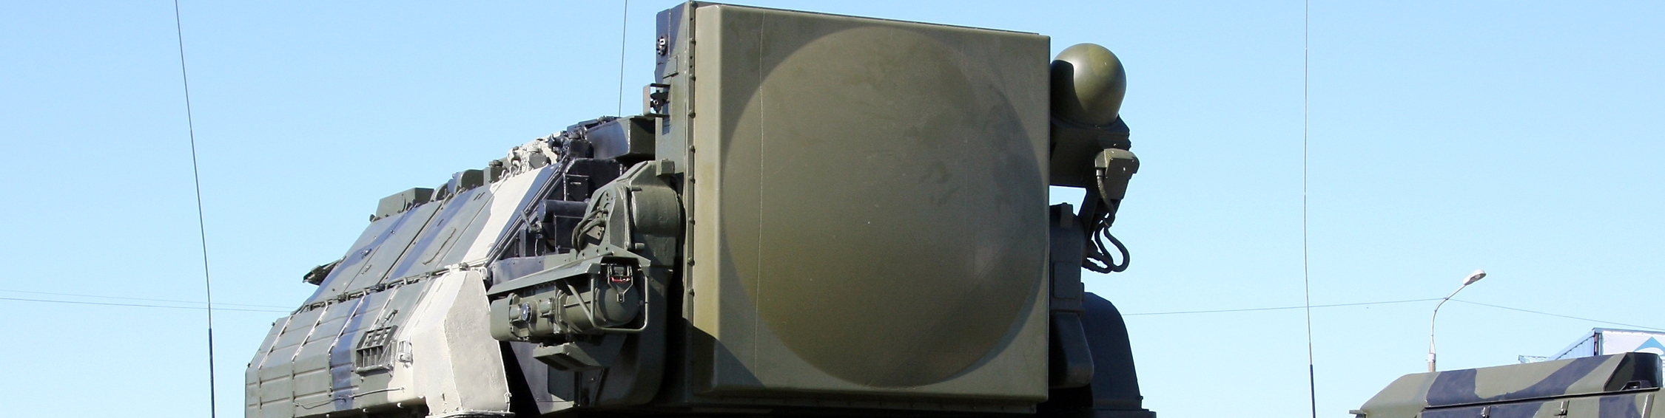
sead

Slide 53
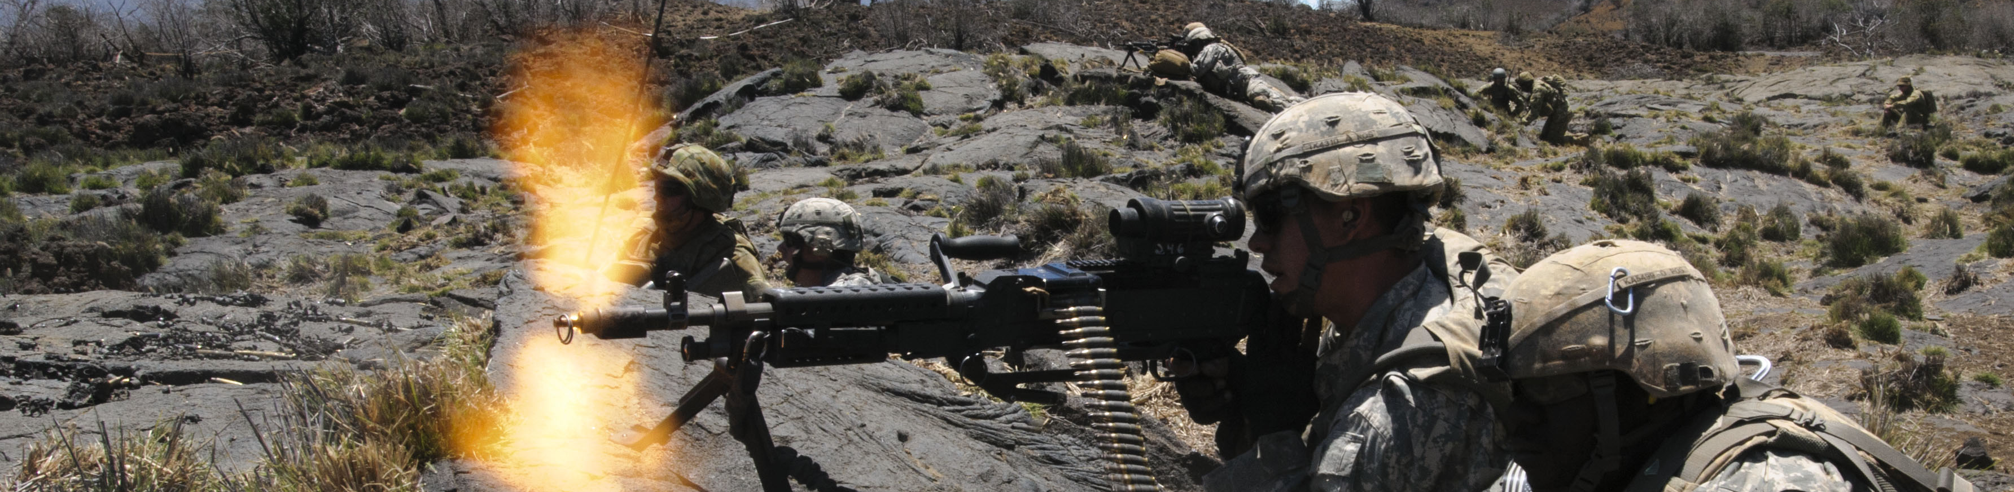
suppression

Slide 54

capture zones

Slide 55
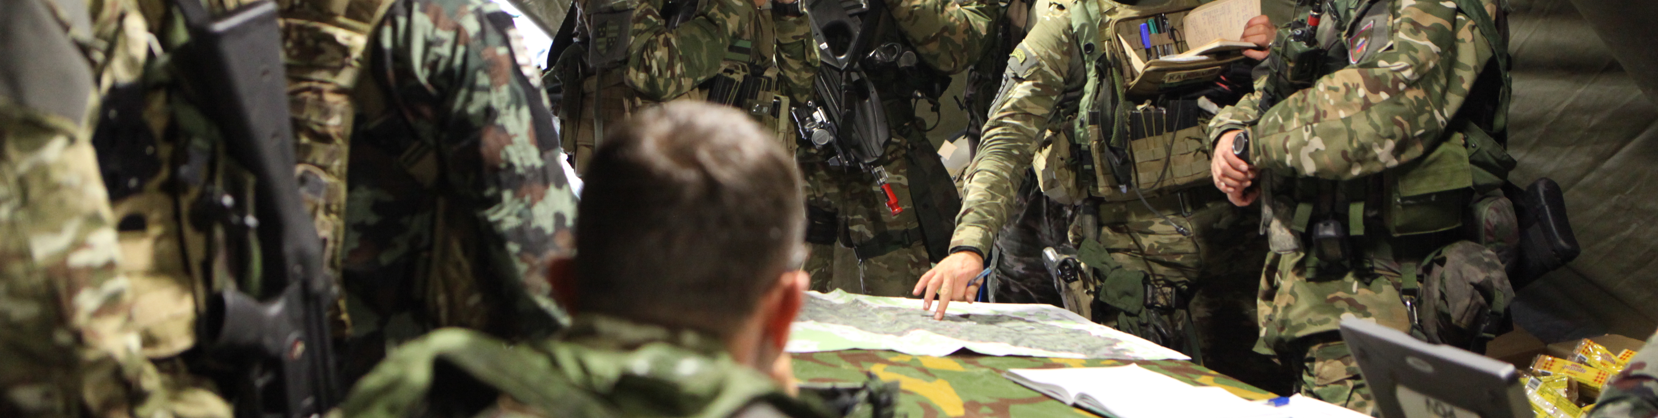
task - mission

Slide 56
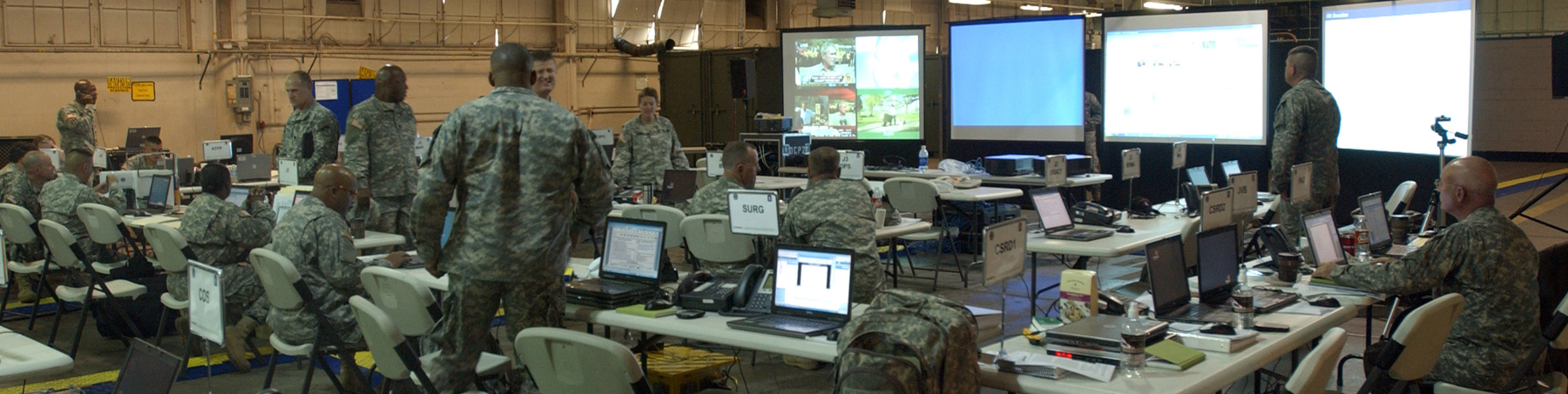
task - command center

Slide 57

tasking - detection manager

Slide 58
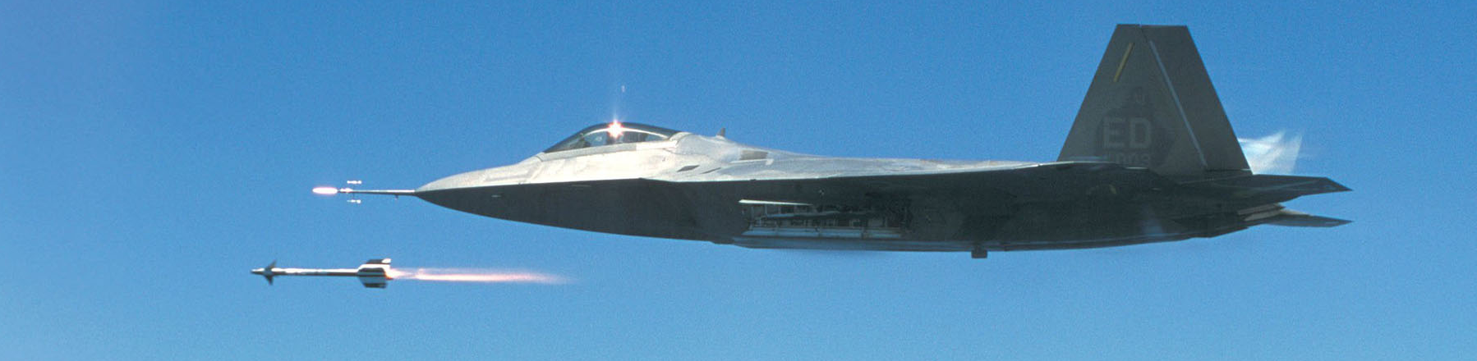
tasking - A2A task dispatcher

Slide 59
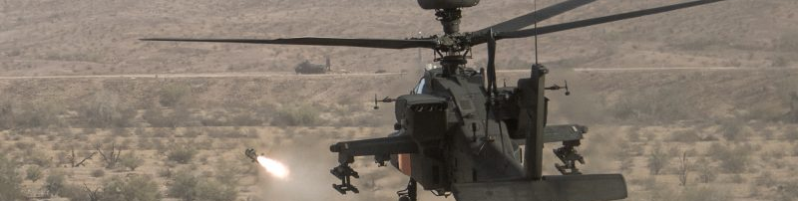
task - A2G dispatcher

Slide 60
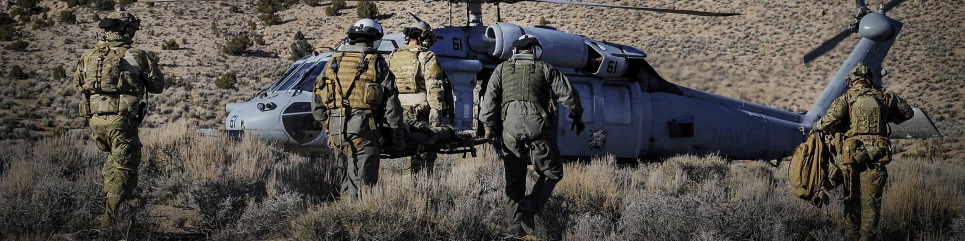
task - cargo csar

Slide 61
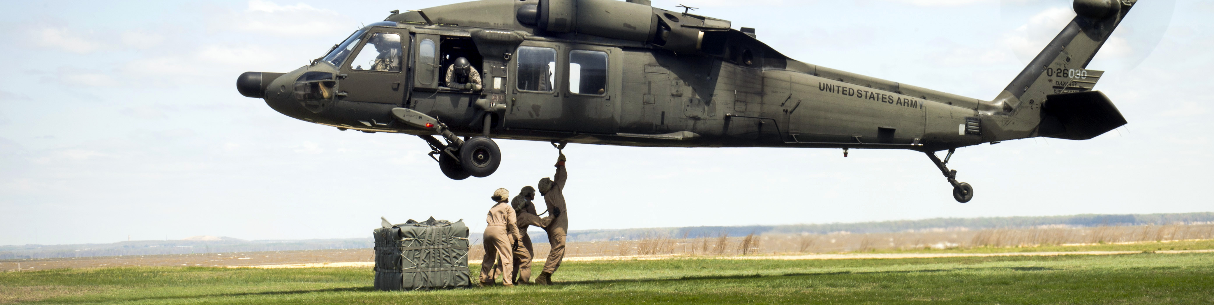
task - cargo transport

Slide 62
task - cargo dispatcher

Slide 63
task - cargo

Slide 64
task - manager

Slide 65
task - task

Slide 66
task - task info

Slide 67
task - task zone capture

Slide 68
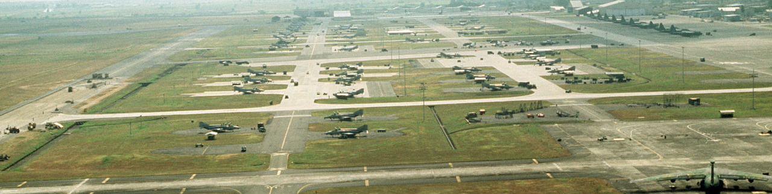
wrapper - airbase

Slide 69
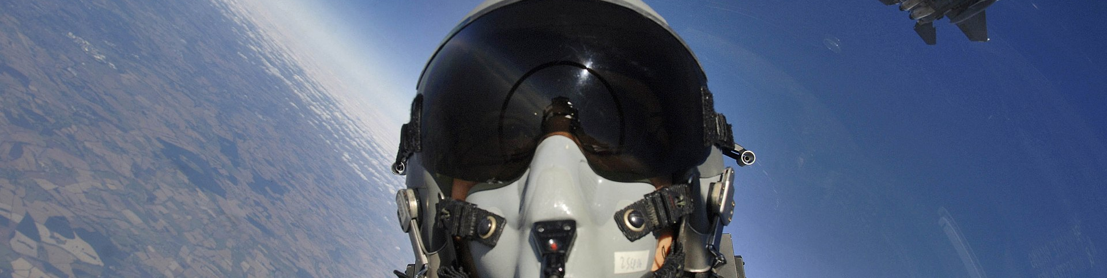
wrapper - client

Slide 70
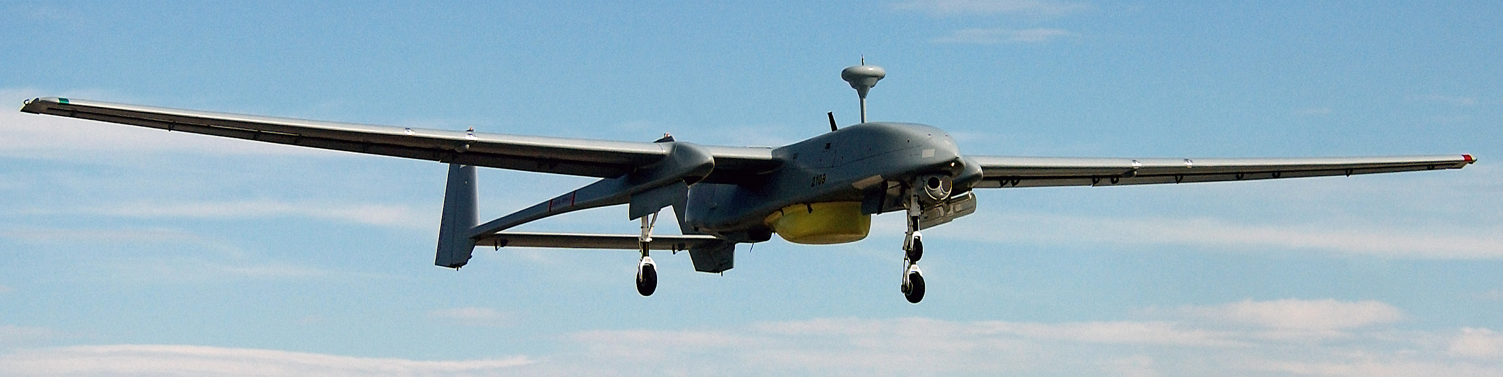
wrapper - controllable

Slide 71
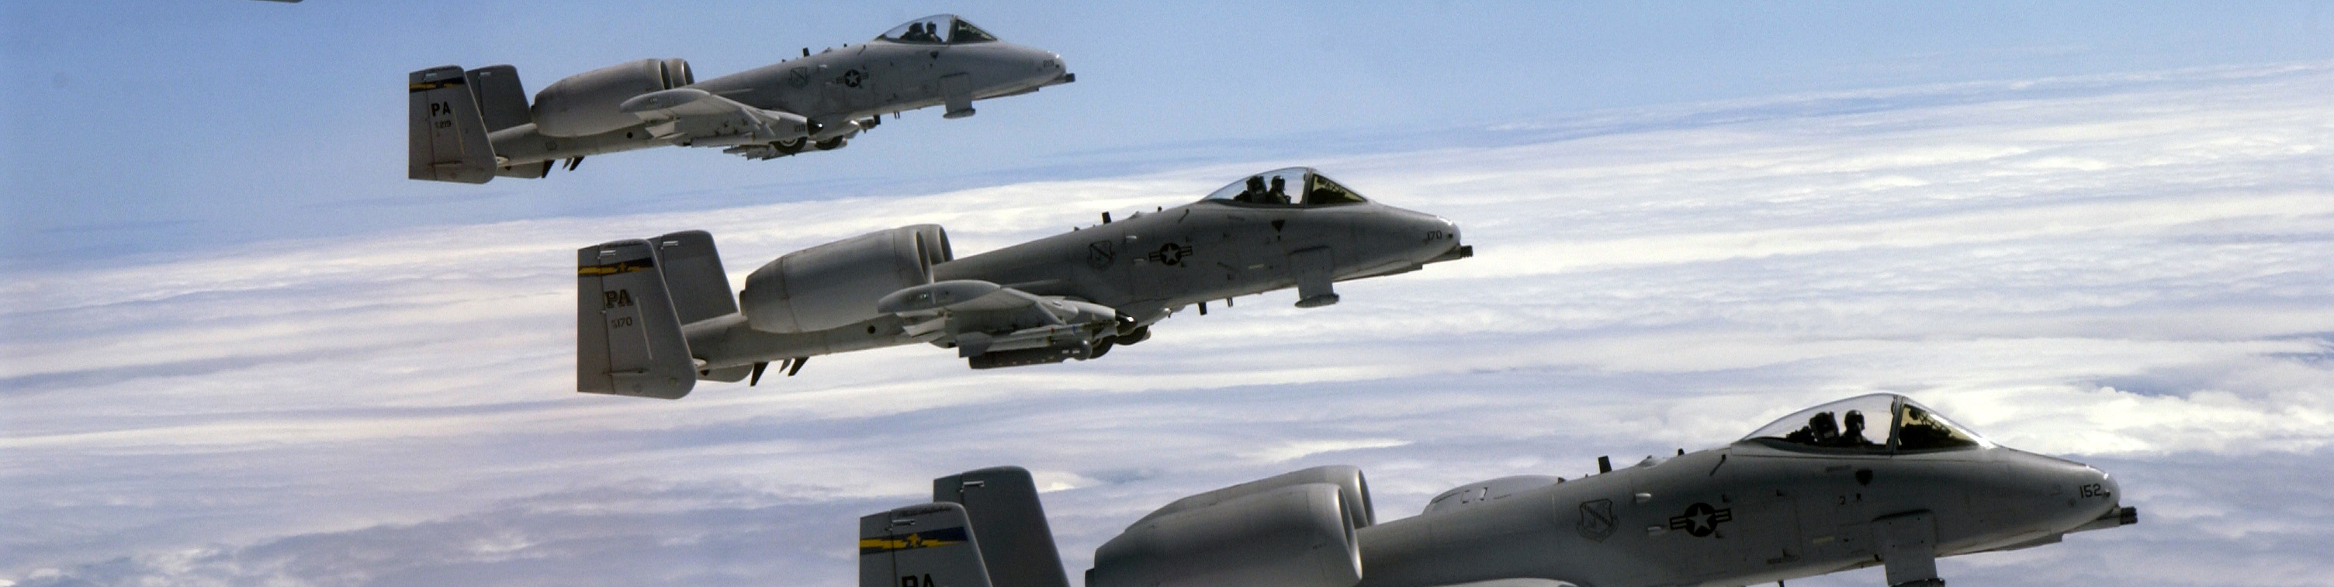
wrapper - group

Slide 72
wrapper - identifiable

Slide 73
wrapper - object

Slide 74
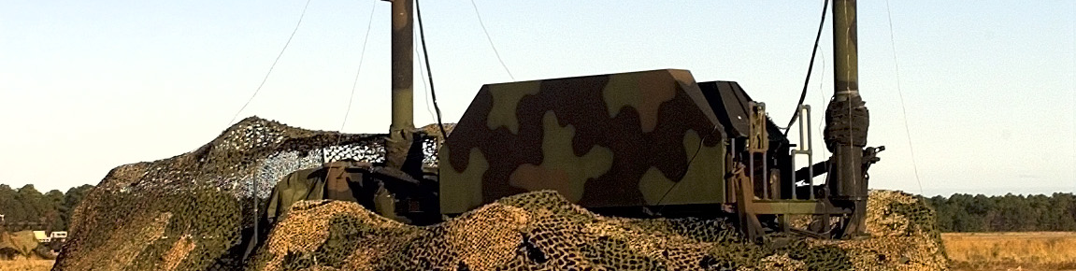
wrapper - positionable

Slide 75
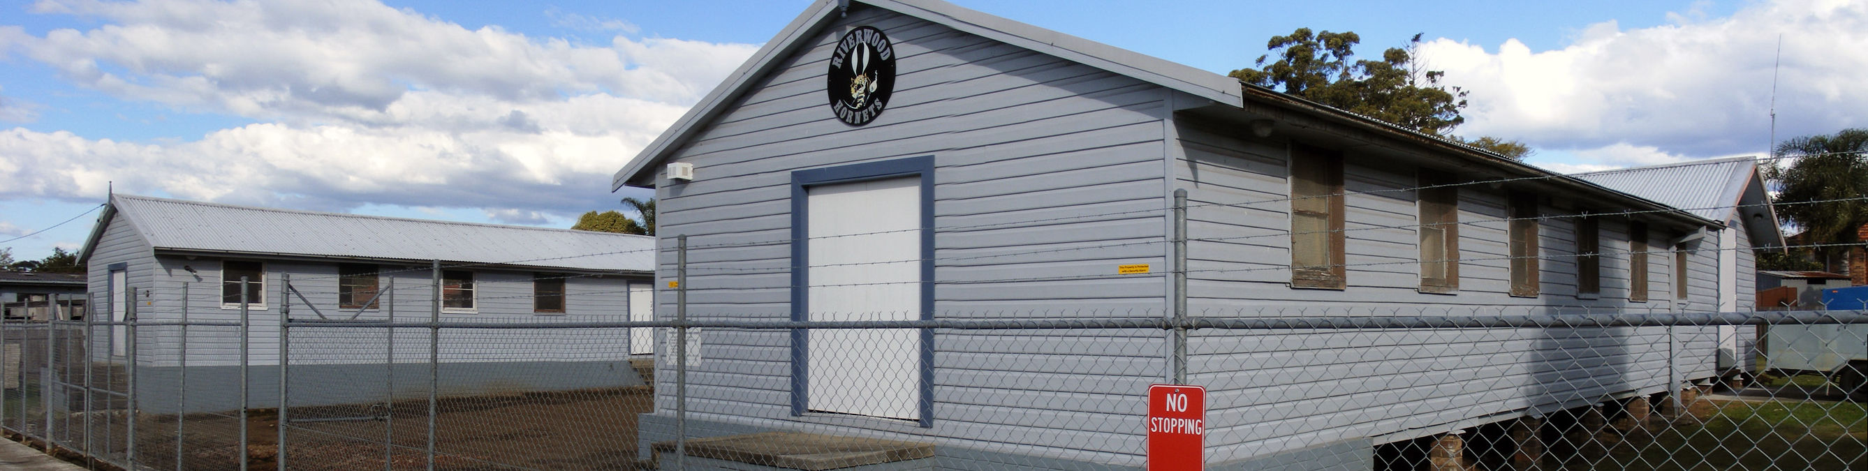
wrapper - scenery

Slide 76
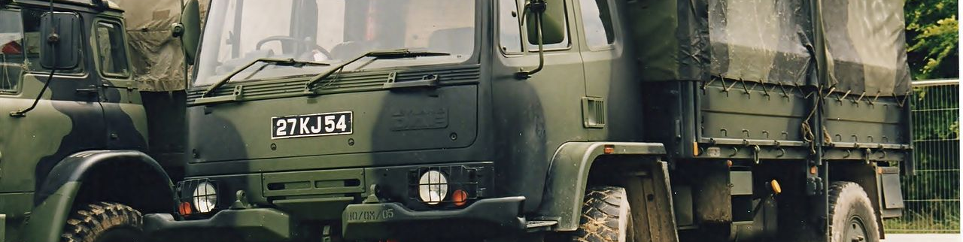
wrapper - static

Slide 77
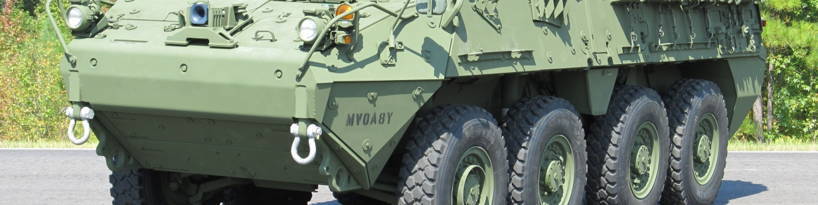
wrapper - unit

